Slide 1
Core Summary Responses & Examiner Comments
Downloaded from www.eslmojo.com

Slide 2

Treetop World
Sample Student Responses and Analysis

Slide 3
Content Points
arrive early
watch people already climbing
put belongings into a zipped pocket
leave anything valuable at home
listen carefully to your guide / remember what guide says
ask the guides for help
wear clothes you don’t mind getting dirty
bring a waterproof jacket

Slide 4
Sample 1

Slide 5
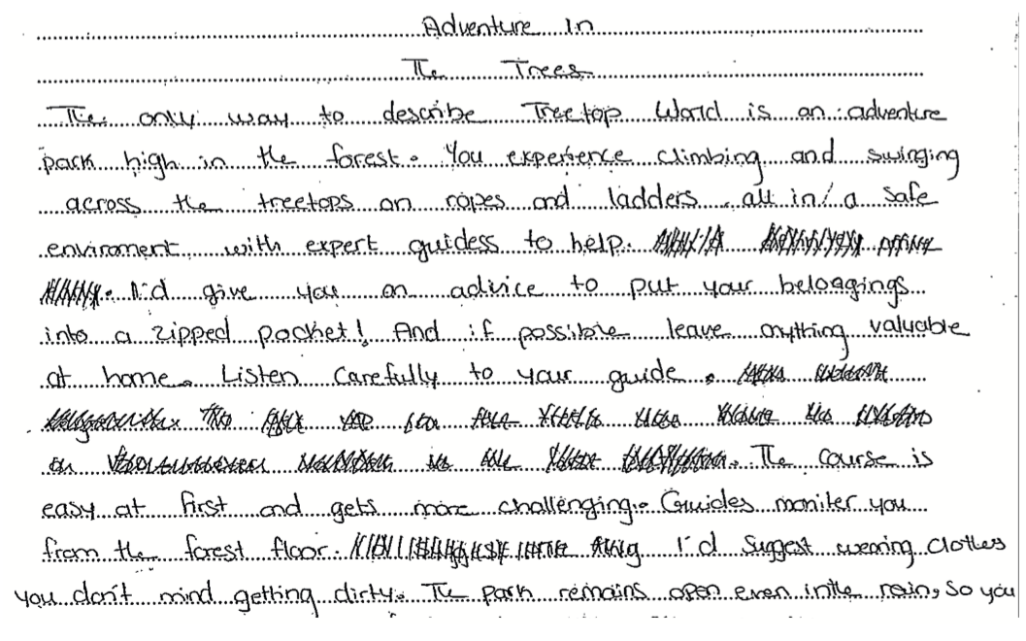


Slide 6
Content
The candidate includes an unnecessarily long description of the park and the activities carried out there. This uses up many words required to address the focus of the task, which is to give advice to visitors. As the response is longer than the requirement for a maximum of 90 words, the final point identified by the candidate, ‘bring waterproof jacket’ is not credited. The response includes four Content points, so the candidate achieves four out of six marks for Content.

Slide 7
Language
The response shows heavy reliance on the language from the text, with little attempt at paraphrasing, either by using synonyms or by re-ordering the grammar of sentences. This reliance on copying limits the Language mark to the bottom band, and this response achieves one mark out of six for Language.

Slide 8
Total
Content 4 + Language 1 = 5/12

Slide 9
Sample 2

Slide 10
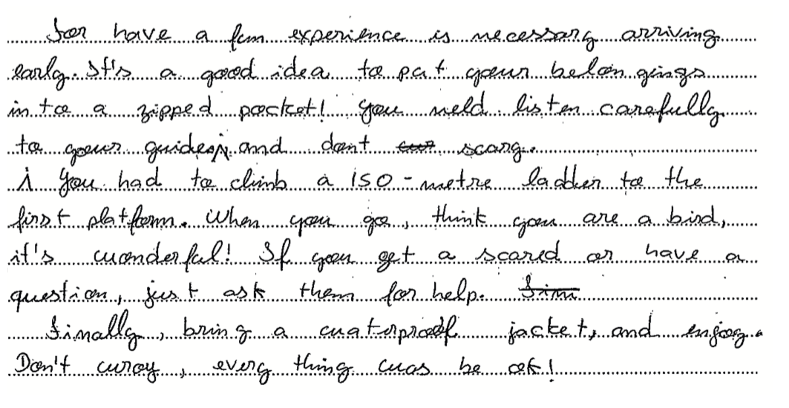







Slide 11
Content
The candidate immediately starts with relevant information. Five of the eight possible points are identified, so the candidate achieves five out of six marks for Content.

Slide 12
Language
The points are presented in a logical order, and there is some attempt to connect ideas, using linking words such as ‘and,’ ‘when’, ‘if’, and ‘finally’. The candidate attempts to use their own words, for example ‘is necessary arriving early’ and ‘when you go think you are a bird’. Overall there is some reliance on the language from the text both in grammar and vocabulary. The candidate shows a reasonable level of accuracy of grammar and vocabulary, and the response achieves three marks out of six for Language.

Slide 13
Total
Content 5 + Language 3 = 8/12

Slide 14
Sample 3

Slide 15
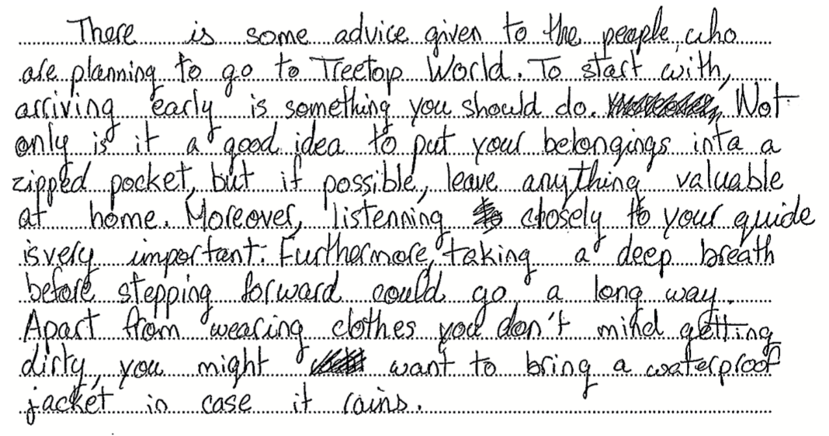














Slide 16
Content
The candidate writes a brief introduction and then immediately starts with advice. Six of the eight possible Content points are identified, so the candidate achieves full marks for Content.

Slide 17
Language
The summary is written clearly and shows good organisation. There is cohesion through the use of linking words and phrases, for example ‘To start with...’, Not only...’ and ‘Apart from...’. The candidate demonstrates good use of their own words, for example ‘something you should do’ for ‘I’d recommend’ and ‘listening closely to your guide is very important’ for ‘listen carefully to your guide you won’t regret it’. However, the response is longer than 90 words, and although it fits the top band criteria, because it is too long, it can only be credited with four marks for Language.

Slide 18
Total
Content 6 + Language 4 = 10/12

